Slide 1
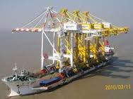
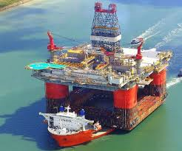
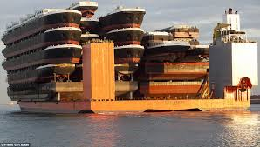
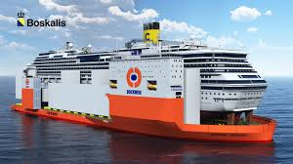
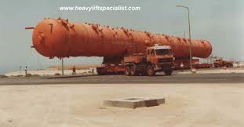
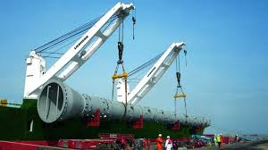
Loading Deck Cargo
Any limits?

Slide 2
Items to think about before saying “Yes, we can carry it.”
Strength
Stability
Visibility
Drainage
Safe Access

Slide 3
Strength –the deck or hatchcover needs to be strong enough to support the cargo.
Sailing
Arrival

Slide 4
Stability
Don’t forget that the weight you are planning to load will be at a very high KG (distance from the keel) so will bring the ship closer, quicker, to losing her GM (which quantifies her stability).
Imagine carrying a heavy weight on your shoulders, as opposed to around your waist.

Slide 5
Visibility
Isn’t there something in the IRPCS that says something about keeping a lookout?
Rule 5 “Every vessel shall at all times maintain a proper look-out by sight and hearing as well as by all available means appropriate in the prevailing circumstances and conditions so as to make a full appraisal of the situation and of the risk of collision.”
So cargo can’t get in the way then?

Slide 6
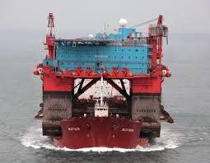

Slide 7
Safe Access
“provide safe access to all parts of the ship”
(Quote from Timber Deck Cargo Regs, also iacs recommendations for access to ship’s structure)
So the employer (ie Captain) has to ensure that all parts of the ship are accessible.

Slide 8
Drainage
Load Line Regulations state that there should be a provision for any water on deck to be easily let back over the side, hence effective camber, scuppers, freeing ports &etc being incorporated into the ship’s structure.
Any Deck Cargo must not restrict this movement of water away from the deck.

