Slide 1
Containers
History:
A USA businessman, Mr Maclcom McClean, looked for a way to reduce costs and speed-up the movement of cargo along the East Coast of the USA. He had the idea of putting everything in big boxes; which cut down on the individual handling of each item (also reduced pilferage –stevedore theft)..

Slide 2
Containers
History:
Initially, all the shippers supplied their own boxes, so Mr Hotpoint would make a box to take 50 washers, Mr Dyson’s box would fit 200 vacuum cleaners. All different shapes & sizes, which was difficult to stow on the ships & wasted space. The idea then went to the standard size box which we have today.

Slide 3
Containers
History:
Being an US invention it was decided that a good size would be:
20feet long x 8feet wide x 8feet6 high
with a maximum gross weight of 25mt
They eventually accepted bigger boxes for bigger volume cargoes:
the 40ft long box with a max weight of 35mt

Slide 4
Containers
Why these dimensions?
To fit on trucks & railways
To fit under road bridges & tunnels
To stay within maximum road & rail weights.
Notice anything?
No input from the ships!

Slide 5
Containers
The Ships then had to adapt to a different way of carrying cargo, move away from the labour intensive old fashioned method where small pieces of cargo was hand-stowed, or maybe with a forklift, into position, to the new idea of a bigger box being dropped (Sorry! we don’t do this with cargo, we lower it gently!) into its stowage position by a crane.

Slide 6
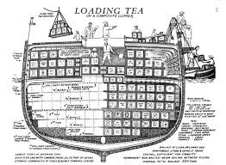
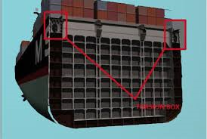
Containers
Gone then was the conventional “General Cargo” design, to be replaced by a construction designed purely for containers:

Slide 7
Containers
So now shipbuilders had to adjusted their designs to holds being multiples of 8feet wide & multiples of 20feet long, with extra strengthening under the corners of the boxes to support the weight of the box.

Slide 8
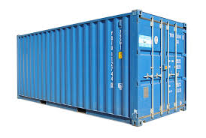
Containers
A “standard” 20footer.
Identification number
Double door at one end,
Secure-able & weathertight
Feet at each corner –the only
Points that touch the floor so
takes all the weight.
Option to move
by forklift
Design at all eight corners
to allow lifting and securing

Slide 9
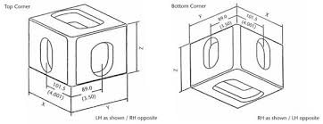
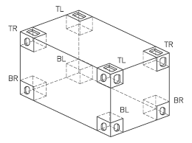
Containers
This is the construction at all eight corners:

Slide 10
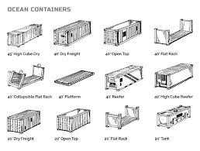
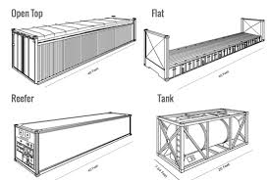
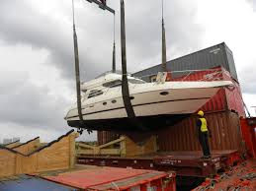
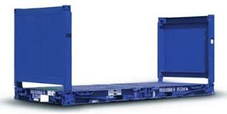
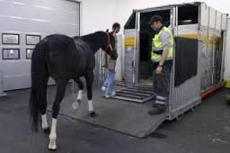
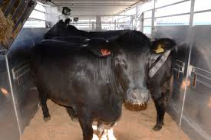
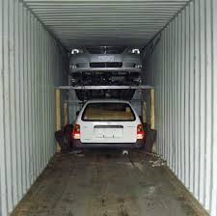
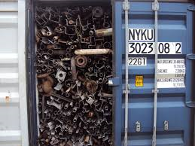
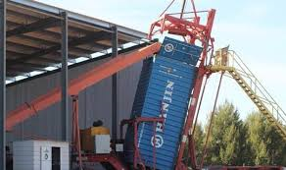
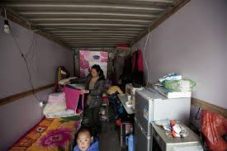
So what cargoes can be carried by container?
Just about any type, Carrying anything:

Slide 11
Anything?
What about frozen cargoes?
An insulated container would keep the cargo frozen, but originally these boxes were fitted with diesel generators, which powered the box’s own refrigeration plant. This has developed into electrically run machines, the boxes still having their own refrigeration plant, but run on electricity, being plugged into the ship’s supply. Care should be taken to ensure temperatures are checked on loading & daily afterwards. To maintain volume, the box is sometimes extended by 5ft.

Slide 12
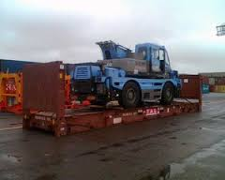
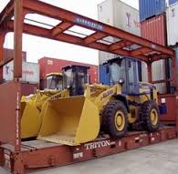
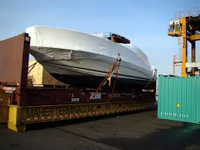
Anything?
What about oversize cargoes?
These cargoes are loaded on “flats” & are usually loaded as top-stow, but middle picture shows can be overstowed.

Slide 13
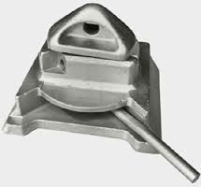
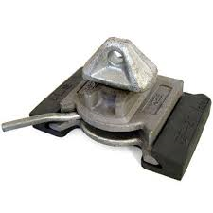
Containers
Now let’s introduce Mr Twistlock, he invented a system that could secure containers together, and to the ship, truck or rail-wagon:
The idea being that an oblong cone fit through the elongated hole & was then twisted through 90° so it couldn’t be extracted.
Open Locked

Slide 14
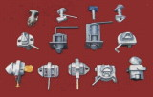
Containers
These have now been developed further to include automatic locking & release systems, doing away with the manual securing.

Slide 15
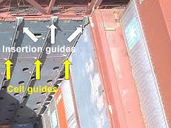
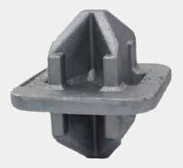
Containers
So, would these “twistlocks” be sufficient to secure a hold cargo?
Probably not even required, as the holds are multiples of 8feet wide, so can’t move!
Plus the shipbuilders usually
introduce “cell guides” as
positioning aids.
Holding in place by double
ended cones would be sufficient.

Slide 16
Containers
So, would these “twistlocks” be sufficient to secure a deck cargo?
Probably, but . . .
always better to be safe!

Slide 17
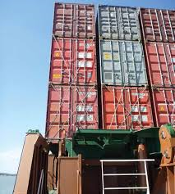
Containers
Insurers have suggested that extra lashings are put on deck cargoes:
These are steel bars of
the correct length that are
fitted as shown.
The amount of lashing will vary from ship to ship, the
requirements would be in the
“Cargo Securing Manual”

Slide 18
Containers
So how big can these container ships be?
Mr McClean thought his barge of 200 was big, now we are looking at ships carrying 20,000+ TEUs.
TEU? It varies, some say Totally Enclosed Unit, others Twentyfoot Equivalent Unit, so we also get the FEU, Fortyfoot Equivalent Unit.

Slide 19
Containers
If we have 20000teus on a ship won’t our cargo plan look a bit complicated? Yes & to make it simpler, every position on a ship can be identified by a 6 figure code:
The 1st two referring to the position longitudinally, the 2nd two referring to the thwartship position, & the final two referring to the height.
So the cargo plan can be reduced to a computer generated list.
Have a look at: http://www.containerhandbuch.de/chb_e/stra/index.html?/chb_e/stra/stra_01_03_03.html

Slide 20
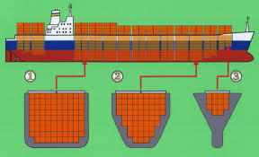
Containers
1st two numbers: Bay number counting from forward, numbered with odd numbers for 20’teus, so going 01, 03, 05, 07 &etc.
2nd two numbers: Row number counting from the centreline, odd to starboard, even to port.
3rd two numbers: Tier number counting from the tank top with even numbers, so the bottom one is 02, & above the main deck starting at 80, so 82 would be on the hatchcover.

Slide 21
Containers
Why are bays in odd numbers? Over two 20’s you can put a 40’, so a 40’ over bay 01 & 03 would be described as “02”.
Why do heights go up in twos? Half height teus are moderately popular for heavy cargoes (eg steel), so two half-heights on the tank top would be 01 & 02, with the next full height one being 04.
Why do deck cargoes start at 80? Because the Yanks chose a big two-figure number.
So if my TEU is in position 011792 I should be worried? Yes, it is on the front row, right out on the starboard side, six tiers above the hatchcovers.
So if my container was in position 130104? Relax, it is seven bays from forward, next to the centreline on the starboard side, below deck, 2nd from the tanktop.
& if my FEU was in 070182? Somebody has screwed-up, the 1st two numbers for a 40’er should be even.
So how high can these numbers go? Totally dependant on the size of your ship, the longer, wider & higher she is, the higher the numbers will go.
How do cranedrivers know where these positions are? They are usually painted on the ship.

Slide 22
Containers
So how does the trade work? The bigger ships (6000+) will carry the cargo to a single discharge port, then the cargo will be distributed from there, often by smaller ships, Feeders (1-1000). Similarly, cargo will be collected by the feeders & taken to a single loadport for the ocean vessel to collect. So your cargo might be carried on three (or more) different ships.
Doesn’t that mean I will have 3 Bs/L? No, the operator will give you a Through B/L that will cover the whole voyage.

Slide 23
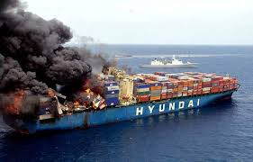
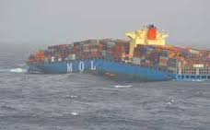
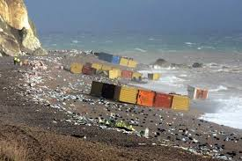
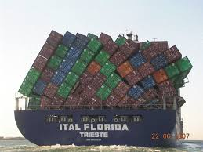
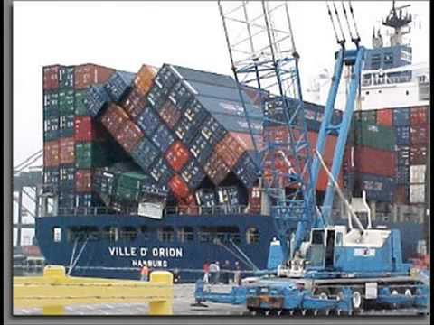
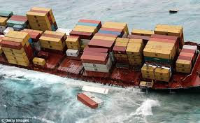
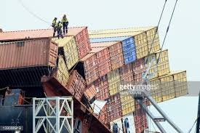
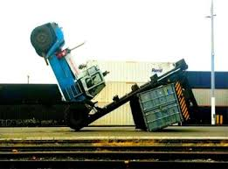
Of course, sometimes things do go wrong

Slide 24
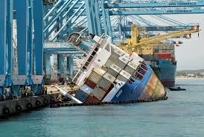
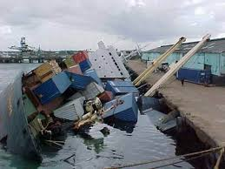
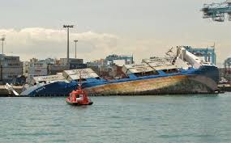
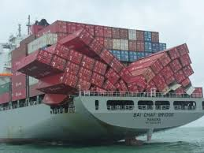

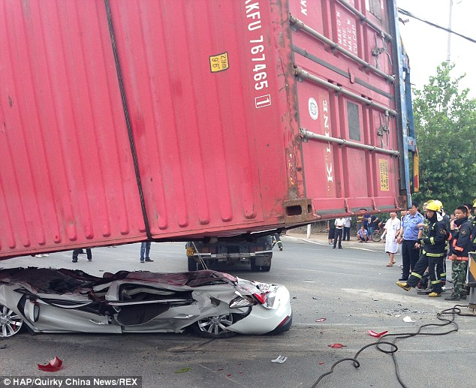

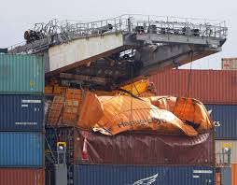

Of course, sometimes things do go wrong (2)

Slide 25
Containers
As they get bigger, so must the ports (ie longer & deeper berths), the handling equipment (ie shore cranes must reach the outboard side) and the infrastructure (the ability for the cargo to be stored and moved to its final destination).
So long as trade exists, ships will be needed; So long as trade grows, bigger ships will be needed: but will the expense of designing & constructing bigger ships and ports be justified?
The big question.

Slide 26
Containers
A thought:
In the 60s & 70s, cargo was carried in 15000dwt ships at around 12-15kts, loading & discharging took around two weeks.
So, to move 1million tons 5000Nmiles in a month would take 67 ships.
Now, an 18000 teu (basis 15mt/teu = 270,000mt) ship loads in two days & does 20+kts. So, 4 of these ships can move the same cargo in 13 days
Where did all the jobs for the crews go?

