Slide 1
Deck Cargo
It is loaded, now, how to secure it?

Slide 2
Deck Cargo
What can we use?
Wires, Chains, Rope, “Tomming-off”, Brackets, Welding, Straps, Blutack, Double-sided Sellotape, Gravity, Prayer, ?

Slide 3
Deck Cargo
Wires
Chains All these require some form of
Rope Tightening Device.
Straps
“Tomming-off”
Brackets
Welding
Blutack, Gravity, Gaffer Tape,
Double-sided Sellotape, Prayer,
Can we take these as “non-starters”?

Slide 4
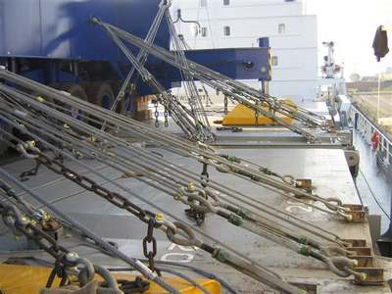
Deck Cargo
Wires & Turnbuckles.
All lashings have to be independent, all items within the lashing system have have to be strength tested, so there are no weak parts.
A rough guide: a 32mm wire lashing system with all the correct size turnbuckles, shackles &etc will have a SWL of around 20mt.

Slide 5

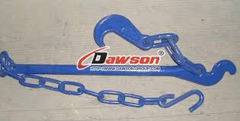
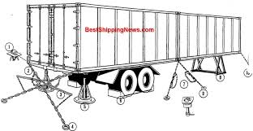
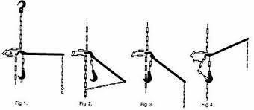
Deck Cargo
Chain with tensioner.
Such an arrangement (top right) would be able to be hand-carried, links of around 100mm & have a SWL of around 10mt.

Slide 6
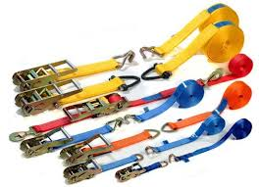
Deck Cargo
Ratchet Straps.
A combined system that has its own tightening and locking device, strength varies with size & construction.
A 50mm ratchet strap would have a SWL of around 5mt.

Slide 7
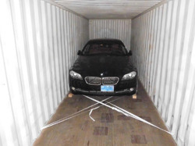
Deck Cargo
Ropes.
A very flexible system, however, not very strong.
A 24mm polyprop rope lashing would have a SML of around 4mt.

Slide 8

Deck Cargo
“Tomming Off”
The art of putting timber baulks between the cargo & a solid surface to stop the cargo moving.
Red bit is timber, yellow bit is wire/chain, black bit is ship structure, eg deck & hatchcoaming.
As strong as your timber!

Slide 9
Deck Cargo
Brackets.
An idea that you place the cargo on deck & weld brackets around it to hold it in place, brackets should be welded close-up to the item. Brackets should be steel & 150-200mm high, 300ishmm in length. It works.

Slide 10
Deck Cargo
Weld.
Simply weld the cargo to the deck or hatch-cover!
Approximate strengths are around 1mt per cm of decent welding.
Don’t try welding trucks or wooden boxes to the deck, it isn’t always successful.

Slide 11
Deck Cargo
So how many lashings should I use?
At this level (calculations come in HND) a good “rule of thumb” would be to use 3 times the weight of the cargo.
So for a 100mt piece of cargo, 300mts-worth of SWL is required: so if using a 32mm wire system with SWL = 20mt, you require 300 / 20 = 15 lashings.
These should be 100mt-worth on each side, with the other 100mt-worth split between Ford & Aft.

Slide 12
Deck Cargo
Bits to remember:
Lashings should be independent.
Lashings should lead down at between 30 & 50 degrees to be effective.
Lashings should be all at the same tension, one tighter than the rest will take all the strain & BREAK
Lashings are to be inspected, adjusted & logged daily.

