Slide 1
Hold Preparation
“the jobs that should be done before loading a cargo”

Slide 2
The Jobs:
Sweep-up the residues of the previous cargoes.
Wash Down.
Rinse.
Dry.
Fumigate / Sweeten
Make Inspection / Report of damage / condition.
Fix damage where possible.
Perform Maintenance.
Check / Test Bilges & Alarms.
Check / Test Watertight integrity.
Check / Test Fire Detecting & Fighting Systems.
Check / test ventilation systems.

Slide 3
Too much too fast?
OK, 1 by 1.
Sweep-up the residues of the previous cargoes.
Possibly the stevedores job, but they never do a good enough job, so brushes, shovels & buckets at the ready, the hold is swept clean. All residues to be lifted out of the hold. (See Marpol for how to dispose of them, officially!)

Slide 4
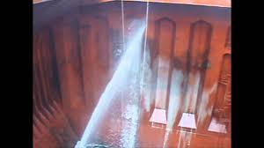
Wash Down
What to use?
Plenty of Sea/Dock Water over the side, so get the engineers to put seawater through the fire main, use a wash-down hose to wash the sides and tank-top; the water going into the bilges to be pumped away through the bilge system.
Yes, the first job could have been missed, but too much cargo residue going through the bilges will clog-up the pipelines & you will not be very popular!
Again, see Marpol to see what you can do with this water.

Slide 5
Rinse.
May not be needed, but a good practice, as there will be salt & other ‘nasties’ in the sea or dock water, that could do damage to your hold &/or the next cargo, so these you need to get rid of, a quick rinse with Fresh Water is needed; this can be expensive, so the accent is on the “rinse” & “quick”; the water going into the bilges as with job (2).

Slide 6
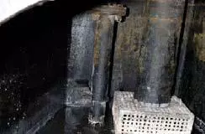
NB (this is a Latin expression for something you should have done -& usually forget!)
As you are throwing loads of
water around the hold, it may
be a good idea to check that the bilge system is clean & actually working before you start. It is always going to be cold and wet when you are doing this job, & you don’t really want to be doing it in a metre of cold wet dirty water.
(just think about where a metre of water will come to!) -Include it in Job (1).

Slide 7
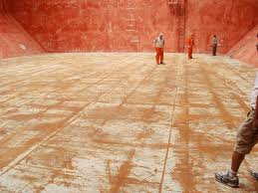
Dry.
Ideally, your ship will be trimmed by the stern, so water on the tanktop should drain aft into the bilges. Your ship is not ideal; so the water has to be assisted to drain aft, with brushes, ‘squeegees’, whatever works.
Over the years your tanktop will become buckled with the weight of the cargoes, &
water will remain within these dents.

Slide 8
Dry.
Hint: If you have water in the tanks underneath the tanktop, take the top couple of cms out so there is air adjacent to the tanktop, it will dry your hold faster. Why? How? I don’t know, but it works.

Slide 9

Fumigate / Sweeten
A remnant from the good old days when bilges were left open, & after a while, didn’t smell very nice. Lime or a disinfectant was used to provide a more aromatic odour.
Fumigation may be required for the next cargo to ensure the space is free
of living things before loading.

Slide 10
Make Inspection / Report of damage / condition.
Whilst the hold is empty, it is a good chance to make a moderately close inspection to list any damages and make a comment on the condition. (Damage identified as occurring during cargo operations should have been identified at the time & reported to apportion blame.) This would include any damages to means of access (ladders).

Slide 11
Fix damage where possible.
This is also a chance for minor repairs to be undertaken by the ship’s staff. Minor bits of cutting / welding can be done safely.

Slide 12
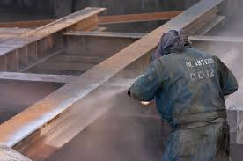
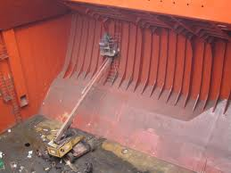
Perform Maintenance.
Again a chance to undertake maintenance within the hold and its environs.
A good chance to scrape rust off the sides of the hold & possibly re-painting the hold.
Be aware that some shippers occasionally require holds to be freshly painted, others will require that no fresh paint was applied for the previous say, 3, cargoes.

Slide 13
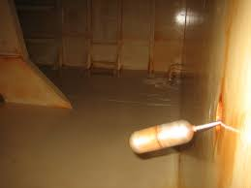
Check / Test Bilges & Alarms.
The bilges are where any water in the hold is collected, if this volume of water looks like it will overflow into the hold space, then it has to be emptied. An alarm should be fitted so that the engine room is aware of the level and can remove the water.
The alarm is usually a ‘ballcock’ arrangement, (as in a toilet cistern) where the ball makes an electrical contact when it floats at a certain level. This can be tested easily by lifting the ball until the alarm sounds.

Slide 14
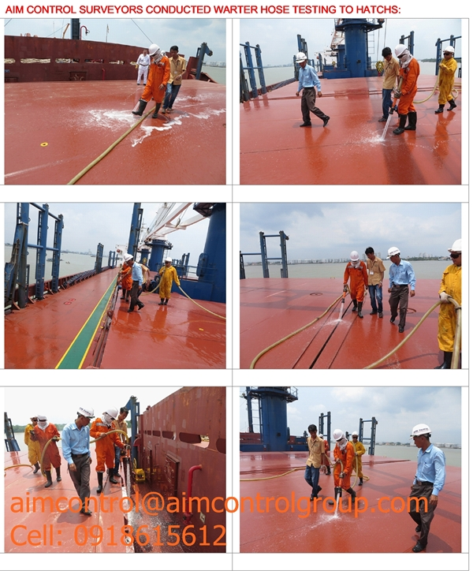
Check / Test Watertight integrity.
A perfect time to ensure the watertight integrity of the hold is OK. Simply close and secure the hatchcover, play water over the joints with a wash-down hose, somebody in the hold Will detect any leaks. These should be inspected and repaired before loading the next cargo.

Slide 15
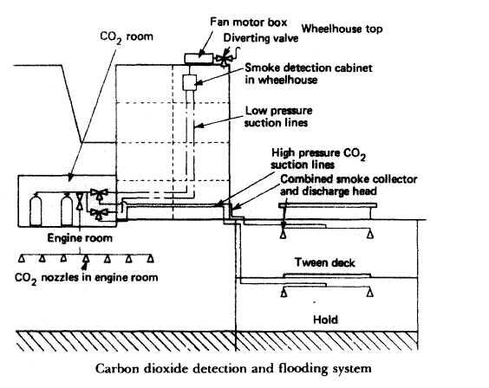
Check / Test Fire Detection & Fighting Systems.
Most ships will have a fire detection & fighting system for the cargo spaces (dedicated ore carriers are exempt) &, of course, these need to be tested.
The system usually works by means of a pipe from the hold, air is sucked through & passed through a photo-electric cell, this will detect any smoke. This pipe can also be used to put CO₂ into the hold. Remnants of cargo can lodge in the line, which can be cleared by blowing compressed air through it.

Slide 16
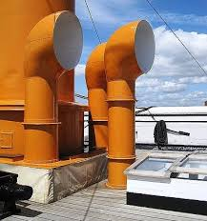
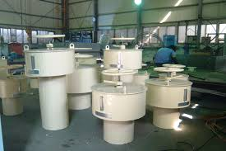
Check / test ventilation systems.
Again, a good (ie only) time to verify the ventilation system is working.
The good-old fashioned system of ventilating a space would be to install portable cowls into the hatchcover, which needed to be trimmed with the changing wind directions, these had to be covered if conditions determined venting to be stopped.
The modern system would be a series of ‘mushroom’ vents through the deck, equipped with fans & emergency quick closing devices.

Slide 17
12 Big Jobs!!
What if there isn’t sufficient time between the cargoes?
Make Time!
Obviously, some jobs could be left until the next opportunity, but start at the top & see how far you get; the priority would be roughly the order we have used here.
Given the time, all jobs should be completed. Additionally, this could be the only time to get into the DB tanks under the hold for inspection.

